Slide 1
The present and future HDF Group

Slide 2
New expectations
“Deliverables”
“What about my data in 2080?”
How soon can you do this for me?
Business opportunities and the academy

Slide 3
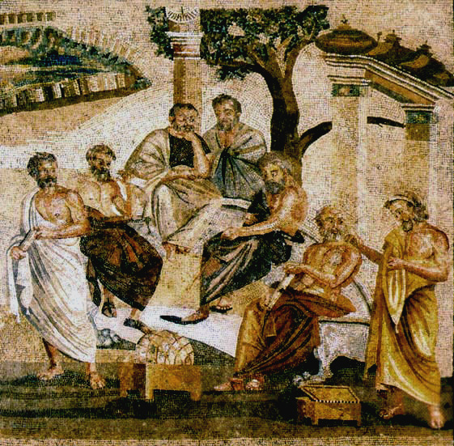
Doing business in academia
We deliver papers, not software.
Data preservation? Talk to the librarian.
I can do that for you maybe by next year.
No profits allowed here!

Slide 4
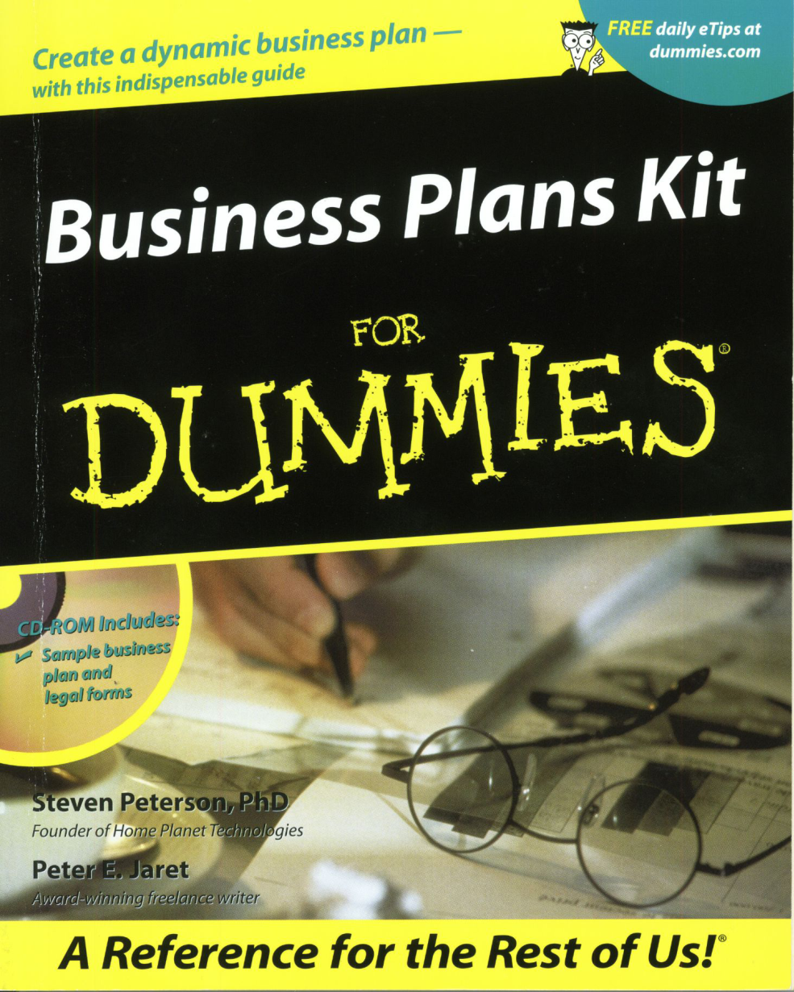
Notes:
Tried to find solns w/in context of Univ.
More than a year working w Office of Vice Chancellor for research, NCSA, others
To look for a way to create a group within the U
More than research group and
could provide these kinds of services to our growing customer base.
Ultimately not successful
Formed a little working group w/in HDF Group to look into creating a company, spinning off from the U.
Got this book, Bus Plans Kit for Dummies, and started working on a bus plan.

Slide 5
Missions and Goals
The five missions
Public
Software
Service
Human
Financial/Structural
Notes:
One of the 1st chapters is about identifying missions and goals
…
These would cover the different aspects of the organization we wanted to create.

Slide 6
HDF Group Mission To ensure long-term accessibility of HDF data through sustainable development and support of HDF technologies.

Slide 7
Spinning off
Business options and questions
For-Profit or not?
How to make money?
Intellectual property
Notes:
Many questions
For profit or not?
How to make money if not-for-profit?
IP.
Put together articles of incorporation, etc, but one problem:
How to bankroll?
Normally there are investors. VC, angel, etc.
Didn’t solve at first.

Slide 8


Help from an unexpected place
Notes:
In Dec. 2004, a company in the finance industry contacted some of our staff about coming to work for them.
A division in the company had discovered HDF5 and were beginning to incorporate the use of HDF5 in dealing with some of their data.
We made a counter offer.
Asked if instead they would be willing to contract with us to address their needs.
They were agreeable, and completely supporting of the open source nature of HDF5.
Problem was, we didn’t actually exist as a company yet,
and we asked them if they would be willing to help us financially in getting the company started.
They agreed! And in late Dec 2004 we incorporated.
Plan was to complete spinoff process in about 6 months.
Took a lot longer, and ultimately we spun off after 18 months, in July of 2006.

Slide 9
Challenges
Managing contracts
Finance
Keeping overhead under control
Defining “profit”
Accounting and budgeting expertise
Business model
Notes:
Cost model includes
Cost of the work
Our salaries and expertise make us competitive
F&A overhead
R&D tax
For non-targeted
Sustainability tax
Other options?
E.g. licensing strategies to provide long-term revenue sources
Cash flow
There’s always a lag b/w when the work’s performed and when it’s rec’d
Build a financial reserve – 3 mos. operational expenses min
This will allow you to operate and preserve cash flow while billables/AR are flowing in
Your lack of a track record can change your charging options
Get lucky –
Find client with a big need for your product and ready cash
Or go the more traditional route
Know your cost structure and benchmarks
People, overhead, good/services, raw materials, facilities, profit
What do we need now, what can we phase in?
Will costs vary by markets?
Valuable old clients’ expectations and needs may not match what is best for you, forcing compromise
What impact will this have on bottom line?
Essential to cash flow, esp. early on
Essential to revenue and making sure you have the right resources to deploy at the right time.
You’ll need to be flexible while working this out
You are learning as you go

Slide 10

The Future
Notes:
That’s pretty much the end of the middle years.
So we’ve covered the history of the HDF project from the beginning to the present.
Now let’s look at the future.

Slide 11
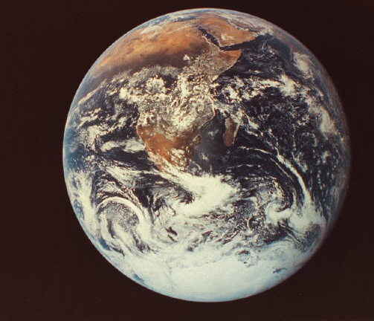
The near future
Notes:
It’s pretty easy to come up with a duration for the early years and the middle years.
It’s quite a bit harder to do that for the future, because who knows how long the future will be?
Nevertheless, I’ve divided the future into two parts, which I’ll call “the near future” and just “the future.”
We’ll start with the near future.

Slide 12
Improving the foundation
From technology driven to market driven
Raising the open source quality bar
Expanding our ability to help customers
Expanding the kinds of things we're good at
Notes:
Not looking so much for dramatic change as just doing things better.
Become better at what we already do
Thereby lay a better foundation to attain our mission of providing high quality support and becoming sustainable.
Four parts to this…
From technology driven to market driven
Raising the open source quality bar
Expanding and improving our ability to help customers
Get better at doing many of the things we already do, and perhaps build expertise in a few new areas.

Slide 13
Preparing to reach mainstream markets
Mainstream Markets
Time
Technology Enthusiasts
Visionaries
Pragmatists
Conservatives
Skeptics
Notes:
Picture captures an important aspect of where we want to go as a company.
Namely, to broaden the base of supporters, hopefully reaching a level of acceptance for HDF that will guarantee sustainability.
In the 1950s someone developed this technology diffusion model.
The idea is that technologies typically begin by serving small markets of technology enthusiasts and visionaries.
As a technology matures and proves itself, more pragmatic users adopt it, and later more conservative communities adopt it.
The pragmatists and conservatives make up a much larger market than enthusiasts and visionaries,
And to become sustainable it is very useful to reach these broader markets.
We’re a technology-driven company with a few customers, and those customers could be thought of as visionaries, people who are willing to take some risk to be able to address data challenges in new and different ways.
In the future, we want to broaden the base of users of HDF.
Strategically will help us not only become more sustainable,
but will make us better at what we do and
enable us to help many more people and organizations that have to deal with data challenges.

Slide 14
Crossing the chasm to mainstream markets
Valley of death for high tech products
Mainstream Markets
Time
Technology Enthusiasts
Visionaries
Pragmatists
Conservatives
Skeptics
Notes:
In the 1990s, observing the .com boom, Geoffrey Moore described what he saw as a problem with technology diffusion model.
Namely, many technologies started out with great promise, but never made it to the mainstream.
The model describes a gap between each of the sectors, but those gaps are small.
Moore argues: gap between Visionaries and pragmatists is much larger.
It’s a chasm, and many tech products never make it across the chasm.
“Valley of death…”
We feel we need to cross that chasm as well.
Moore describes several strategies:
Make sure the cost of entry is low. Don’t assume adopters will be willing to go to a lot of effort to adopt the technology. Thus, focus on quality, easy of use.
Think about the “whole product,” not just the core technology. Pragmatists need the technology to fit in with all of the other technologies they use. We need to make sure our technology integrates well with those other technologies. Having HDF play well with databases and applications like MATLAB are important in this regard.
Focus on capabilities that benefit users, not on cool features that have limited utility.
Don’t try to move into a lot of markets at one time. D-Day strategy: focus on one beach head. Put your energies into winning over that market, then explore others.
These are the kinds of things we are thinking about as we lay our foundation in the near future.

Slide 15
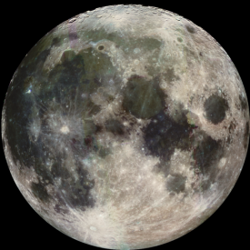

The future
Notes:
Long term future
I’ll focus on:
Tech challenges
Institutional strategies

Slide 16
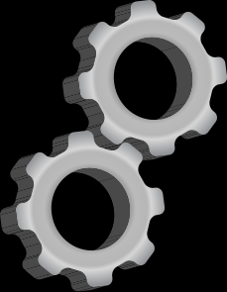
Technological Challenges
Notes:
A simple, durable but evolvable model and implementation
Self-description
Specification documentation
Preservation-based evolution
Providing different ways to view the same information
Integration with preservation frameworks

Slide 17
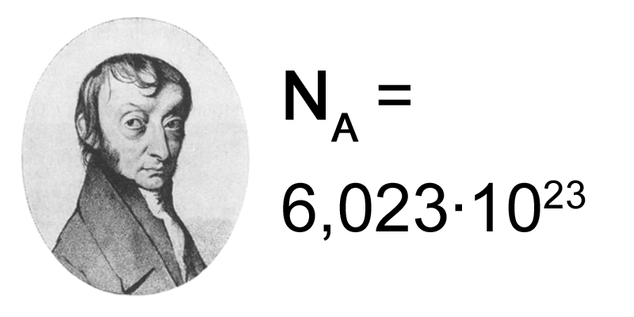
Lots of data
Notes:
Avogadro’s number – the number of carbon atoms in 12 grams – is 602,200,000,000,000,000,000,000
In 12 years the number of bits in the digital universe will surpass Avogadro’s number.*
* The digital universe.

Slide 18
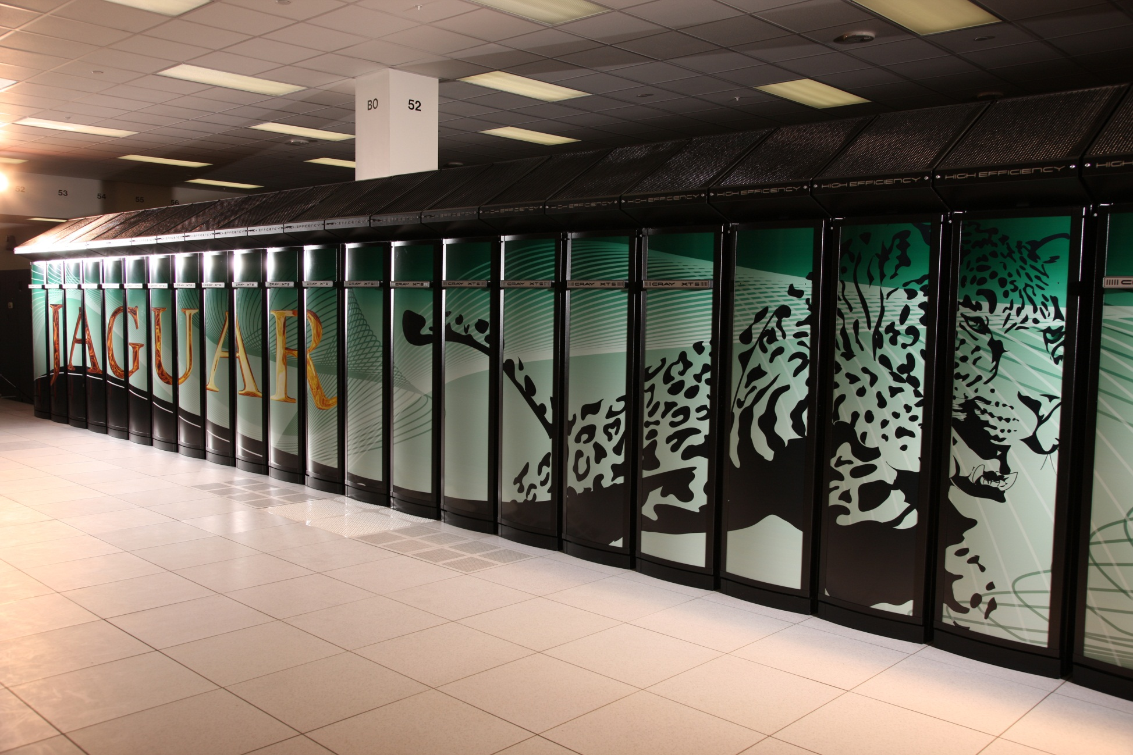
Big data
Cores | Petaflops
224,162 | 1.759
Image courtesy of the National Center for Computational Sciences, Oak Ridge National Laboratory”.
Notes:
In the Fall of 2010, the Jaguar computer at ORNL is the worlds fastest computer.
It has 224,000 cores and performs almost two quadrillion floating-point operations per second.
A number of apps on the Jaguar system use HDF5 and potentially many more could use it.
When your data is being produced collectively and simultaneously on hundreds of thousands of cores, how do you read and write that data efficiently and meaningfully?
We have to be able to deal with issues like these if we really want HDF5 to serve the needs of the users of these systems.
And while we’re just beginning to adapt to petascale systems, the DOE and others are setting their sights on exascale systems.
Just begun two projects, with DOE funding and led by Quincy Koziol and working with DOE labs, that will explore challenges in managing data on exascale systems.
As look towards the future, we see this as an important research thrust in The HDF Group.
The world's fastest supercomputer today, a Cray XT5 system at Oak Ridge National Laboratory that's known as Jaguar, has a peak performance of 2.3 petaflops. A petaflop is a quadrillion, or 1,000 trillion, sustained floating-point operations per second.
The total capacity of the latest Top500 list of the most powerful supercomputers, released at SC09, was 27.6 petaflops, up from 22.6 petaflops in the previous list, released in June.
One exaflop is 1,000 times faster than a petaflop -- performing 1 quintillion, or 1 million trillion calculations per second. "We think exascale is a 100 million-core kind of enterprise," said Dave Turek, vice president of deep computing at IBM.
In mid-2008, IBM's Roadrunner supercomputer -- a hybrid system that runs both AMD's Opteron processors and Cell chips designed by IBM, Toshiba Corp. and Sony Corp. -- was the first to achieve petaflop speeds. Now the U.S. Department of Energy has started making plans to build an exascale system that's 1,000 times more powerful than Jaguar.
These future systems must use less memory per core and more memory bandwidth. Systems running 100 million cores will face continuous core failures, and the tools for dealing with them will have to be rethought "in a dramatic kind of way," said Turek.

Slide 19
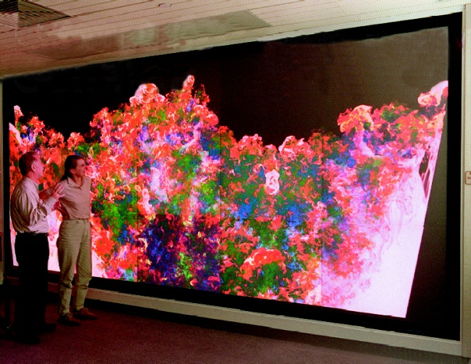
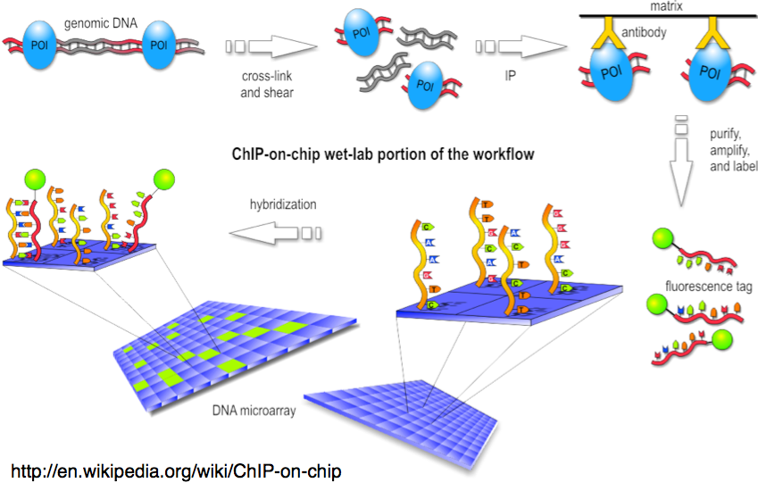
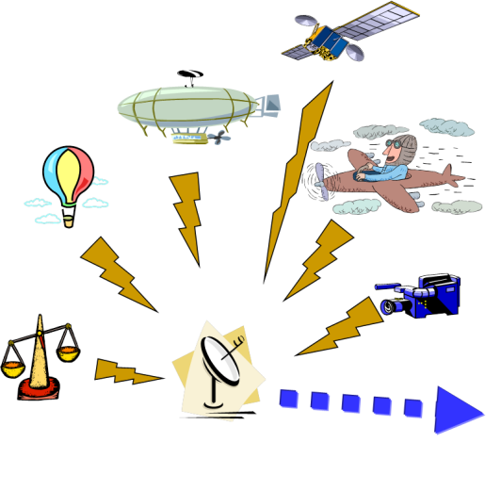
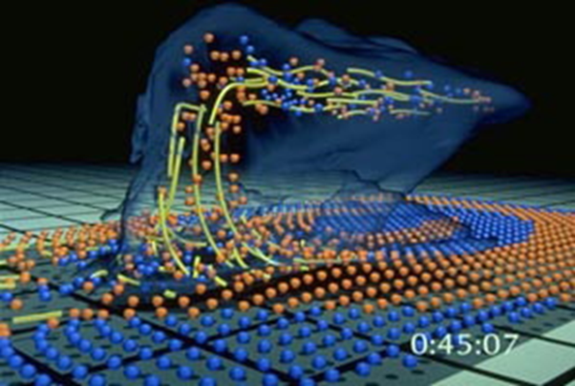

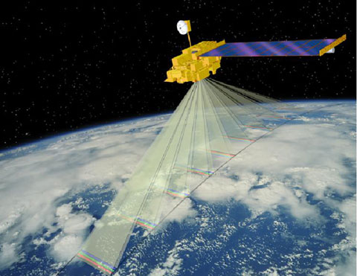
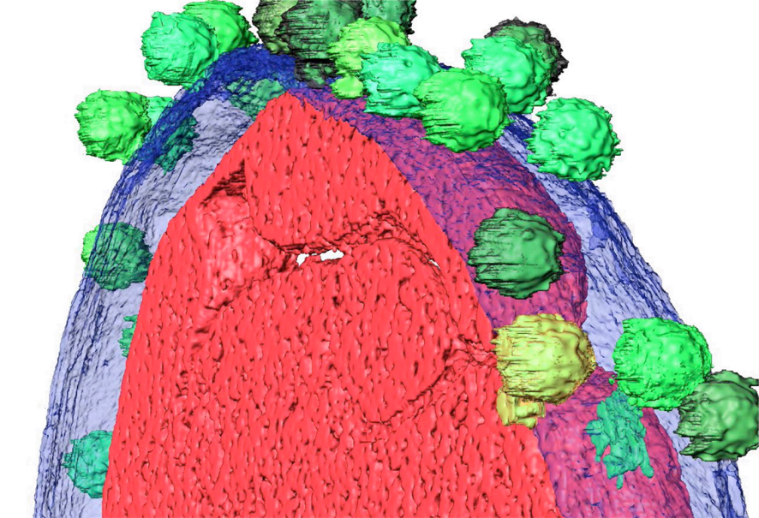
Kinds of data

Slide 20
GFTF Nov 9, 1987

Slide 21
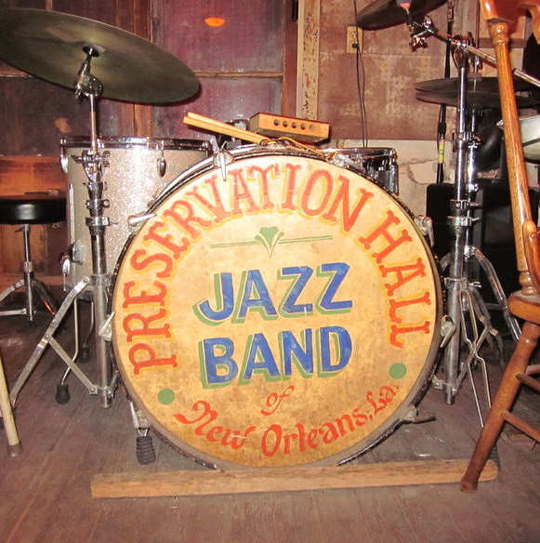
A focus on Preservation
Darwin’s first evolutionary tree - 1837
Notes:
"Evolve with compatibility"
Develop guidelines to keep evolution under control
Develop process to ensure cross-generational compatibility

Slide 22
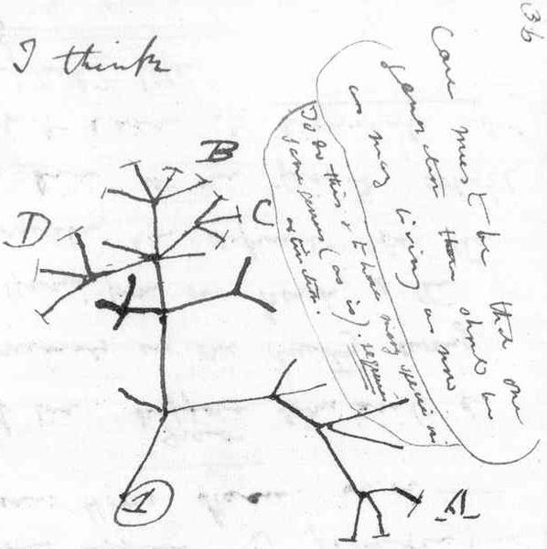
Preservation-based evolution
Darwin’s first evolutionary tree - 1837
Notes:
"Evolve with compatibility"
Develop guidelines to keep evolution under control
Develop process to ensure cross-generational compatibility

Slide 23
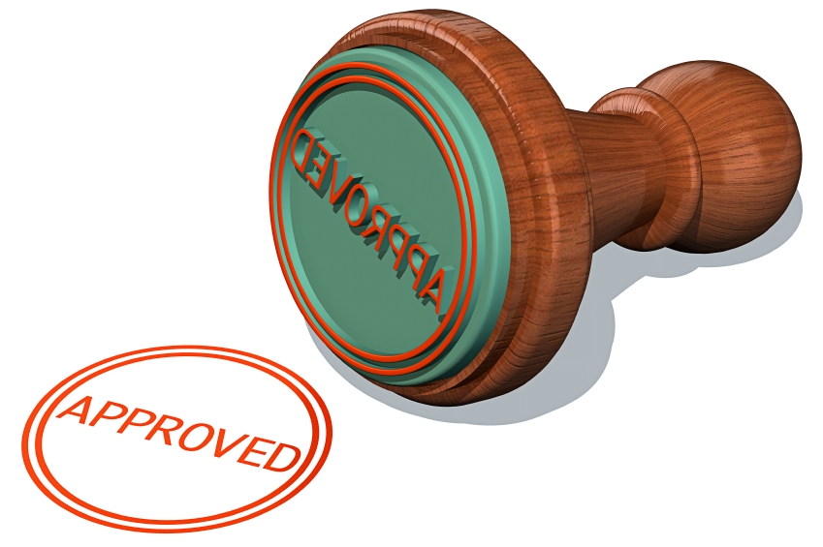
Promoting standardization and interoperability
Notes:
Emphasis on standards.
Organization and with user communities emphasize the importance of developing and adhering to standards.
Make HDF5 itself a national and international standard, and important building block to preservation.
Foster standard uses of HDF5 so that more and more diverse groups can share and integrate data
Promote standard usage within domains
Examples
HDF-EOS
CGNS
HDF Time history (Aerospace)
NeXuS
BioHDF
components
Unified data model
API and implementation (preferably multi-language)
Tools
Lots of data

Slide 24
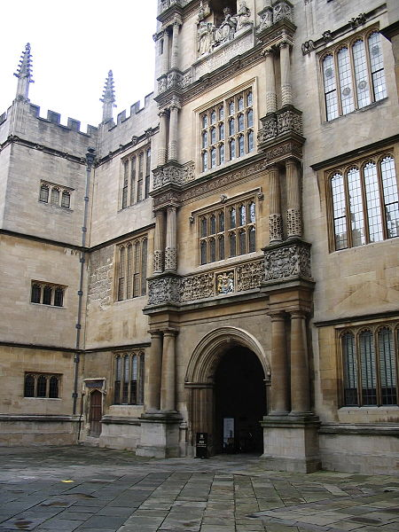
Institutional strategies
Notes:
Long-term institutional support
One keeper of the format and software
A mission-driven business
Open source
Free as in speech, not as in
Cross the chasm to new users and applications
Promoting standardization

Slide 25
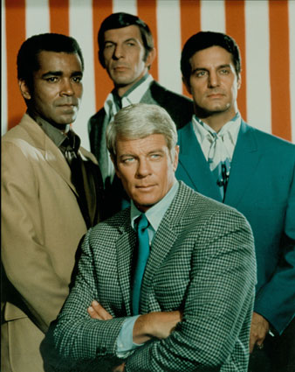
A mission-driven business
Notes:
Continue to be mission driven.
Non-profit to insure mission driven
Not locked in to that model, but whatever model
Continue to focus on supporting the people who are committing their data to HDF and needing access to their data for the long term.

Slide 26
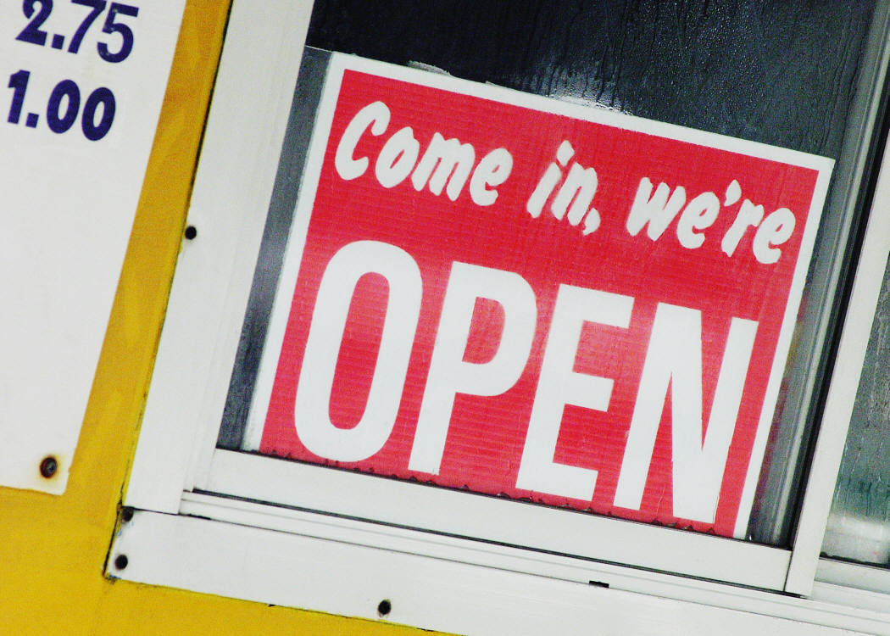
Open source
Notes:
Committed to the open source model for the basic format and software.
Doesn’t mean proprietary products can’t be built on HDF.
Want our IP choices and even our business model to allow that.
OSS has many advantages to our the people we’re trying to serve
Open source lowers barriers to basic access: free and readily accesible
Improves ability of people to understand the SW and adapt it to their needs
IP: applications built on HDF not encumbered by IP requirements
Being OSS definitely helps insure that HDF will have wide community involvement
That’s terribly important.
Users will constantly test HDF, find bugs, identify ways to improve; help us make it better
Have demonstrate countless new uses of, and will continue to do that
Also promote it far beyond what our little group can do.

Slide 27
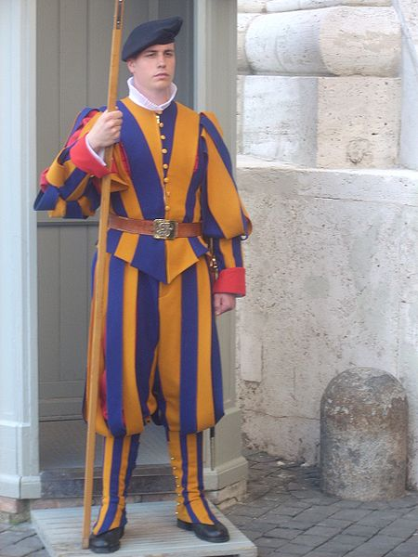
One keeper of the format and software
Notes:
Most open source software projects subscribe to the idea that anyone can contribute to testing it and making it better.
We certainly believe in that premise, but only to a point.
Both HDFs are complex formats, and the software is even more complex.
That complexity limits the extent to which we can incorporate contributions from our users in our core products.
We encourage contributions, but we feel that the quality of the software would be at risk if we didn’t maintain fairly strict control over development and maintenance of HDF.
Another reason we want to have control is to avoid fragmentation. If we don’t have the last word on exactly what constitutes HDF4 or HDF5, then separate versions could emerge from different communities, and much of what makes HDF4 and HDF5 so useful would be lost.
This isn’t to say that the central authority has to always be The HDF Group. It’s entirely possible that a different mechanism could emerge that would manage the maintenance and evolution of HDF.

Slide 28
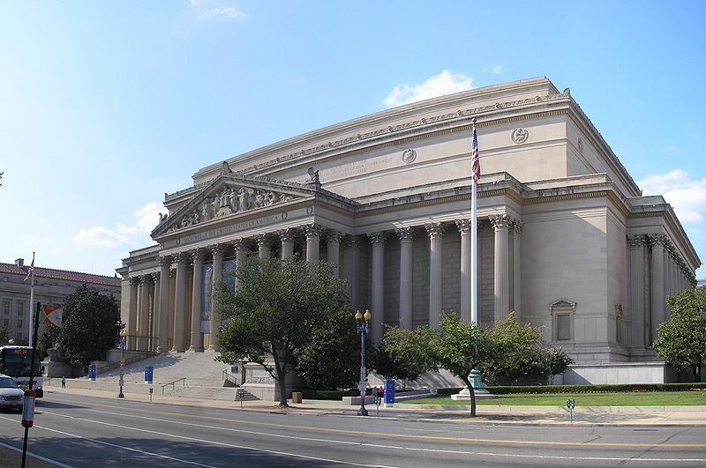
Long-term institutional support
The National Archives, Washington, D.C.
Notes:
Another principle that we believe in is long-term institutional support.
In order to carry out our mission, we feel that we need to create an independent, self-sustaining institution.
As we said earlier, we started this out by defining our mission and vision, by establishing an organization that’s mission driven and by trying to establish a mindset that values accessibility to the data and the software for the long-term.

Slide 29
Human, financial, legal foundations for sustainability
Notes:
Find a business model that builds assets and is sustainable
Find the right IP strategy that balances openness with stewardship
Develop sustainability assets: knowledge, people, finances
We’re not there yet on any of these counts, but this is where we want to be.

Slide 30
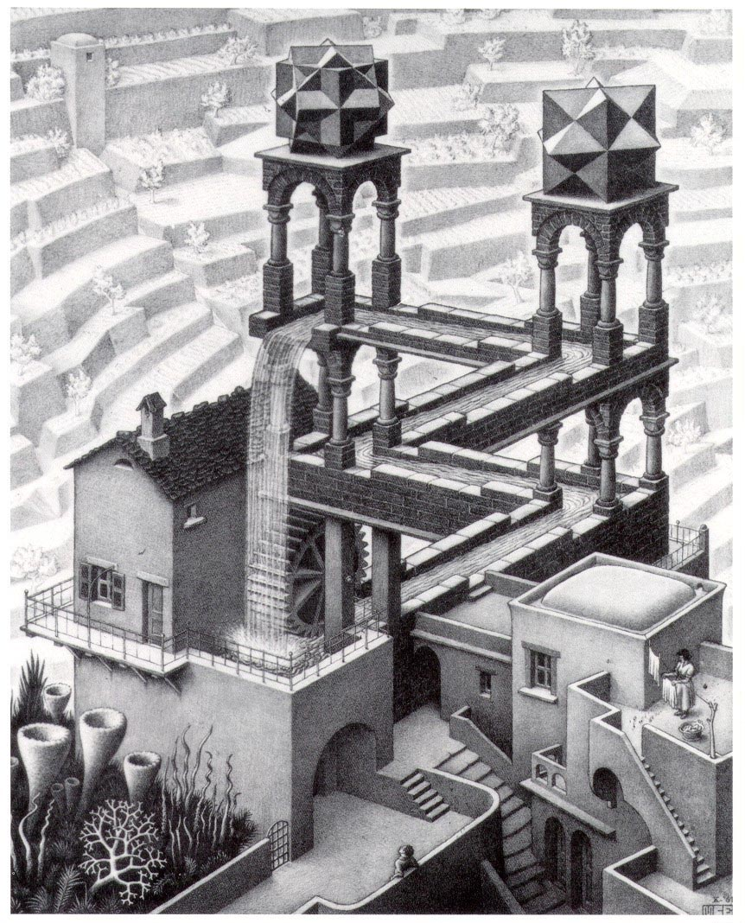
Business model
Notes:
Perhaps our biggest challenge is the business model.
Our current model provides income almost exclusively for services, and that’s a model that so far doesn’t seem to scale very well.
Clearly profits on the sale of the basic software are out of the picture.
Fortunately, a lot of new and creative OS business models are emerging, and there’s probably a lot we can learn from them.
The main point to be made here is that in the future we are going to have to focus on finding a business model that enables us to be sustainable.

Slide 31

A virtual organization
Notes:
Finally, as an institutional strategy, we realize that maintaining a highly centralized operation for the long term is probably not ideal, and perhaps not even viable.
We have a growing base of users and supporters who understand the value of HDF and are ready and willing to contribute with us to evolving and sustaining HDF, as well as to supporting HDF users.
The collective energy and wisdom of this community is enormous, and we are just plain foolish not to take advantage of it. Furthermore, we owe it these folks to let them help sustain HDF.
I’m not just talking about programmers out there with clever ideas about HDF and with the time to contribute. They are obviously tremendously valuable. But I’m also talking about institutional supporters, especially in industry and the government. We envision consortia of organizations that understand the value of keeping alive and well a technology like HDF that helps solve some of our biggest data challenges.
Thanks to the web, technologies are already in place to build and manage widely dispersed groups of people working together with a common goal. These technologies will only get better in the future.
But we are also seeing government initiatives, such as the National Science Foundation’s Scientific Software Innovations Institutes, that could provide the institutional support that’s needed.
We need to learn how to use these technologies and institutional opportunities to expand The HDF Group into a virtual organization that embraces the resources and wisdom of the people and organizations I have been talking about for the past hour, for they are really the ones who make HDF what it is.

Slide 32
The End

